Slide 1
juquery
TEAM
18BTRSE031 - T. ASWIN BARATH
18BTRSE026 - SOUVIK KAR
18BTRSE027 - R. SRISARVESH
18BTRSE033 - VYSHNAV RAJ

Slide 2
Table of Contents.
Introduction
Design and implementation techniques
Er diagaram
Use case diagram
Class diagram
User side activity diagram
Administrator side activity diagram
Expected outcomes
Upcoming works

Slide 3
Introduction
“JUQuery” is a platform for the purpose of knowing about the academic and unacademic environment, campus life of a student, faculty and student relationship of Jain University in virtual way.
This application provides us with complete information about campus life in student point of view, academic information in college point of view.

Slide 4
It features a familiar and well-thought-out and attractive user interface, much like posting a query, giving a response to a query, helping a student through a peronal chat if required.
A user has a complete freedom to post any query, can also make a funny post in legal way.
Also students can register/ host any campus related events and also can take the feedbacks from other students through this platform.

Slide 5
Design and implementation techniques

Slide 6
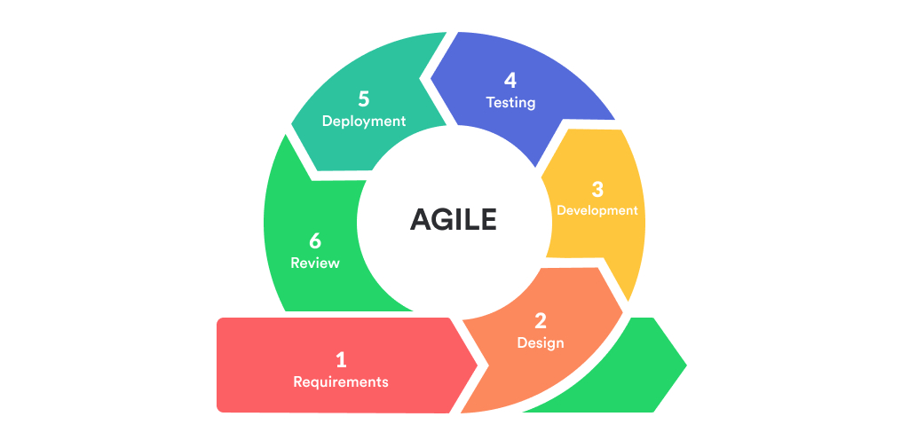
Agile sdlc methodology

Slide 7
1. Functional programming using functional components
The functional programming is a concept of creating pure functions for software logic.
It avoids concepts of mutable data and a shared state as used in Object-oriented programming. The functional programming is based more on expressions and declarations rather the statements.
The functional programming depends only on the arguments passed to the function.
In React, a functional component is a plain JavaScript function that returns JSX.

Slide 8
In functional programming, data cannot be stored in objects and it can only be transformed by creating functions.
Functional components lack a significant amount of features as compared to class-based components. The gap is made up with the help of a special ReactJS concept called “hooks”. Hooks are special functions that allow ReactJS features to be used in functional components.
So, in our project we have incorporated functional programming using functional components where we pass data as shared state through functional arguments.

Slide 9
2. State management using Redux.js library
Redux is a predictable state container designed to help us write JavaScript apps that behave consistently across client, server, and native environments and are easy to test.
With Redux, the state of your application is kept in a store, and each component can access any state that it needs from this store.
State management is essentially a way to facilitate communication and sharing of data across components.

Slide 10
It creates a tangible data structure to represent the state of your app that you can read from and write to.
As it's mostly used as a state management tool with React, we have taken advantage of it to manage states of our platform event triggers such as user login/logout, show/hide popup, user inputs to provide a user friendly experience.

Slide 11
3. Specific re-rendering using ReactDOM in React.js
In React every UI piece is a component, and each component has a state.
React follows the observable pattern and listens for state changes.
When the state of a component changes, React updates the virtual DOM tree.
Once the virtual DOM has been updated, React then compares the current version of the virtual DOM with the previous version of the virtual DOM. This process is called “diffing”.

Slide 12
Once React knows which virtual DOM objects have changed, then React updates only those objects, in the real DOM.
This makes the performance far better when compared to manipulating the real DOM directly.
This makes React standout as a high performance JavaScript library.
ReactDOM.render() controls the contents of the container node you pass in. Any existing DOM elements inside are replaced when first called. Later calls use React’s DOM diffing algorithm for efficient updates.

Slide 13
We have taken advantage of this React.js feature to re-render only those part of the website which requires a refresh saving a lot of data usage from the user' experience with our platform

Slide 14
4. Secure API authentication using Firebase
Firebase Authentication is an extensible token-based auth system and provides out-of-the-box integrations with the most common providers such as Google, Facebook, and Twitter, among others.
It enables us to use custom claims which we’ll leverage to build a flexible role-based API.
The Firebase API is secured via tokens—in order to generate such a token, we need to call Firebase’s Client SDK and log in with a valid user/password credential.
When successful, Firebase will send a token back in the response which we can then add to the header of any following request we want to perform.

Slide 15
We take leverage over this secure features of Firebase Authentication API to keep our users secure and gain their trust over our platform's user experience
Firebase gives us complete control over authentication by allowing you to authenticate users or devices using secure JSON Web Tokens (JWTs).
we generate these tokens on your server, pass them back to a client device, and then use them to authenticate via the signInWithCustomToken() method To reduce problems promoting code changes from development to staging to production, instead of including API keys in the code itself, either set them as environment variables or include them in a configuration file.

Slide 16
5. Real time fetching data using Firebase Firestore database
Firebase data is retrieved by either a one time call to GetValueAsync() or attaching to an event on a Firebase Database reference.
The event listener is called once for the initial state of the data and again anytime the data changes.
Firebase is a Backend-as-a-Service (Baas). It provides developers with a variety of tools and services to help them develop quality apps, grow their user base, and earn profit.
It is built on Google's infrastructure.

Slide 17
It is categorized as a NoSQL database program, which stores data in JSON-like documents.
Stores data as collections of documents.
Simple data is easy to store in documents, which are very similar to JSON. Complex, hierarchical data is easier to organize at scale, using sub collections within documents.
Requires less denormalization and data flattening.

Slide 18
Firestore also features richer, faster queries and scales further which is very helpful with Real time fetching of data from backend and rendering data on front-end with a very low latency which makes the user experience very effective.

Slide 19
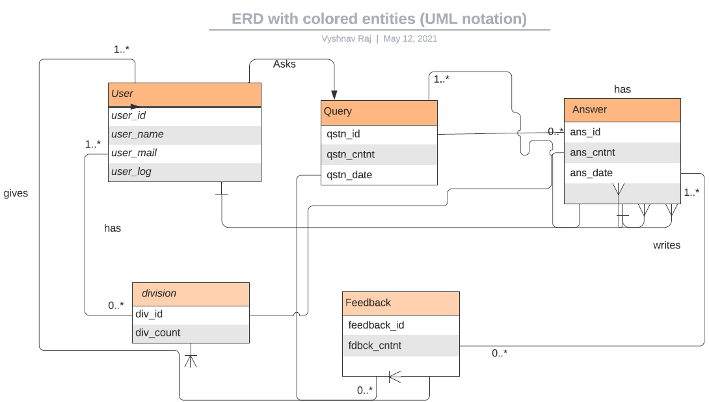
Er diagram

Slide 20
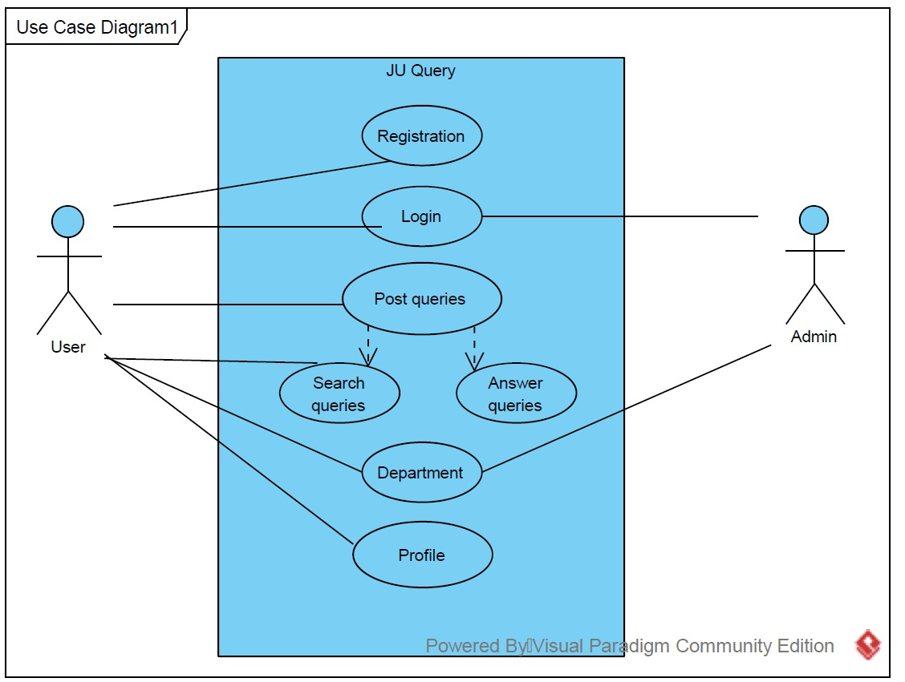
Use case diagram

Slide 21
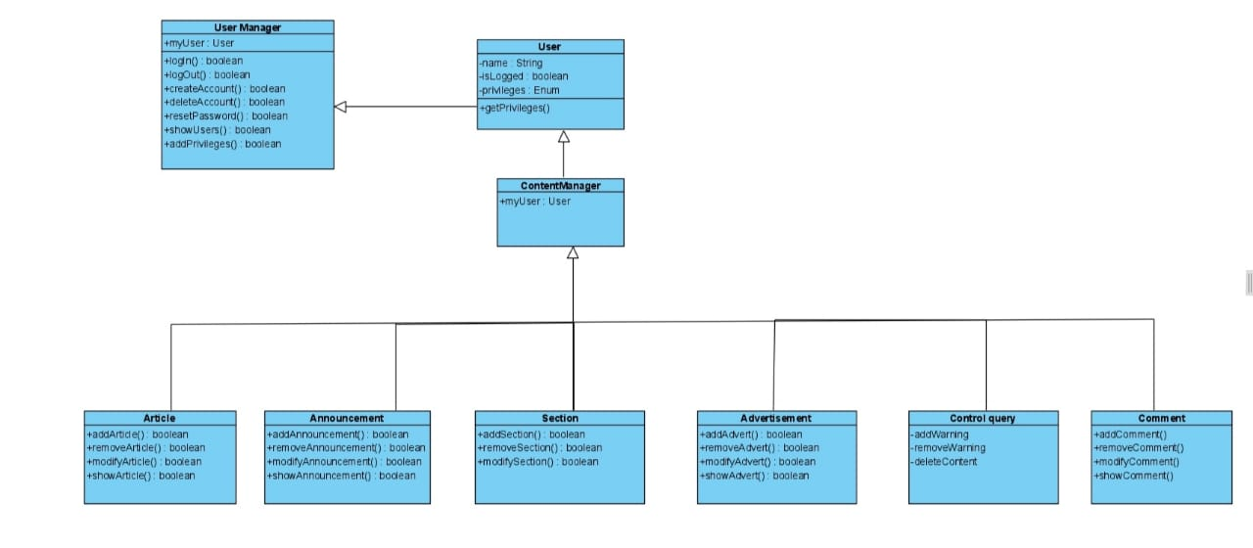
Class diagram

Slide 22
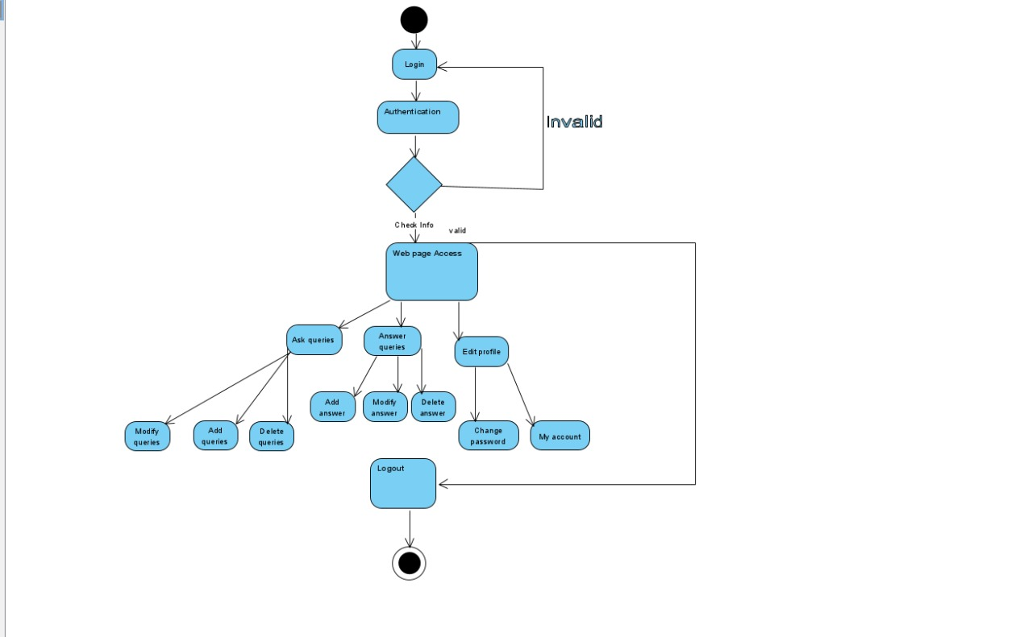
User side activity diagram

Slide 23
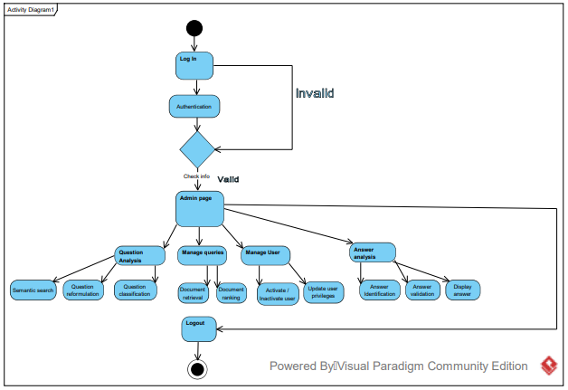
Administrator side activity diagram

Slide 24
Expected outcomes

Slide 25
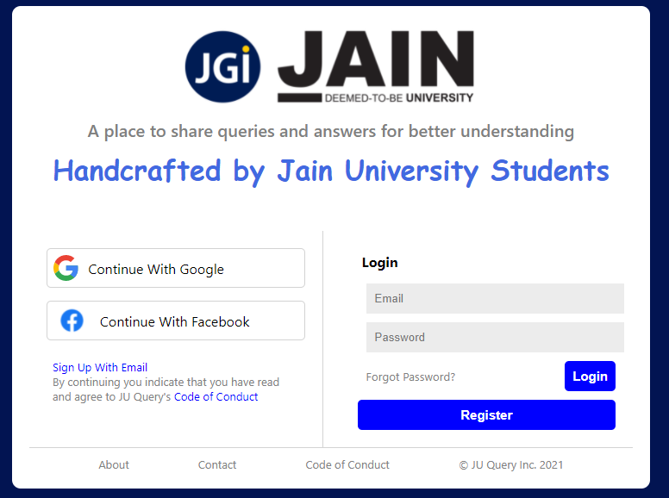
Login/ register page

Slide 26
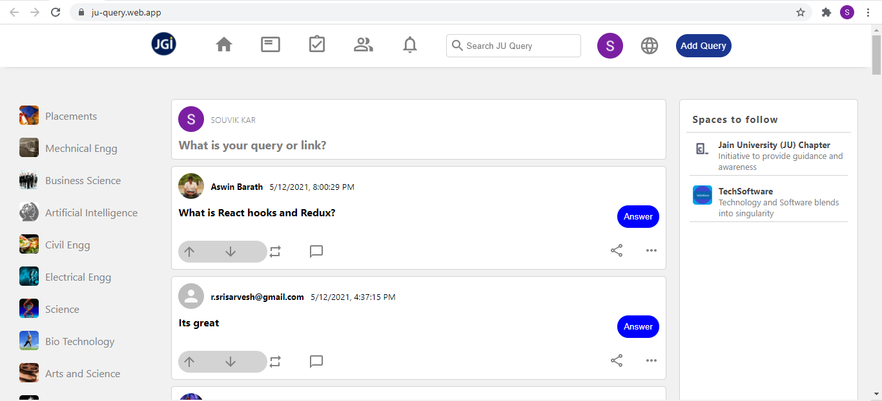
Home page

Slide 27
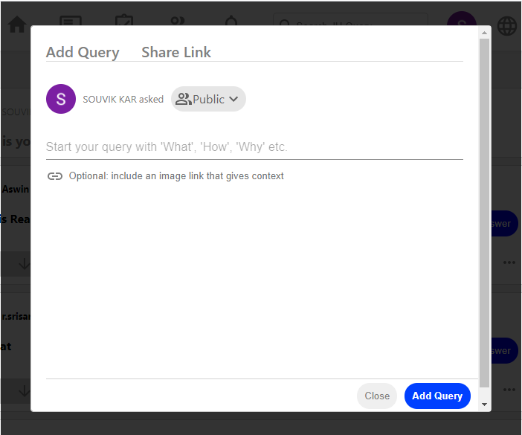
Add query panel

Slide 28
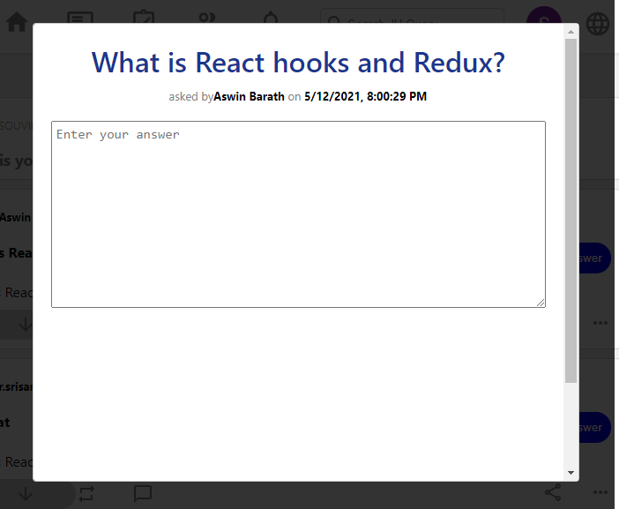
Add answer panel

Slide 29
Upcoming works

Slide 30
Any query?

Slide 31
Thank you ☺

